Slide 1
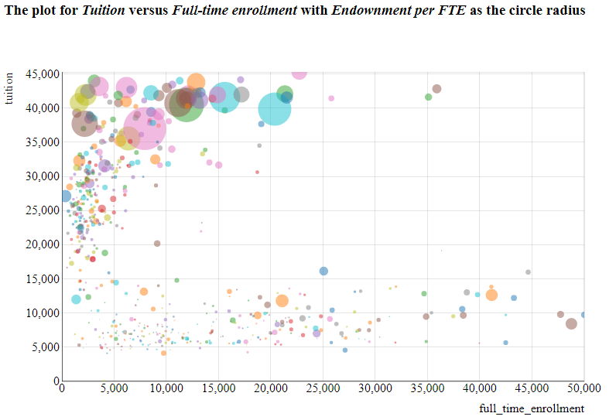
Effect of Tuition fees and Full Time enrollment on Endowment
d3
We observe in the plot that endowment per FTE size is larger for universities that have higher tuition fees. The increase in tuition fees can result in increase in endowment for UTD.
P.S. We have added addition data into json from IPEDS_data.

Slide 2
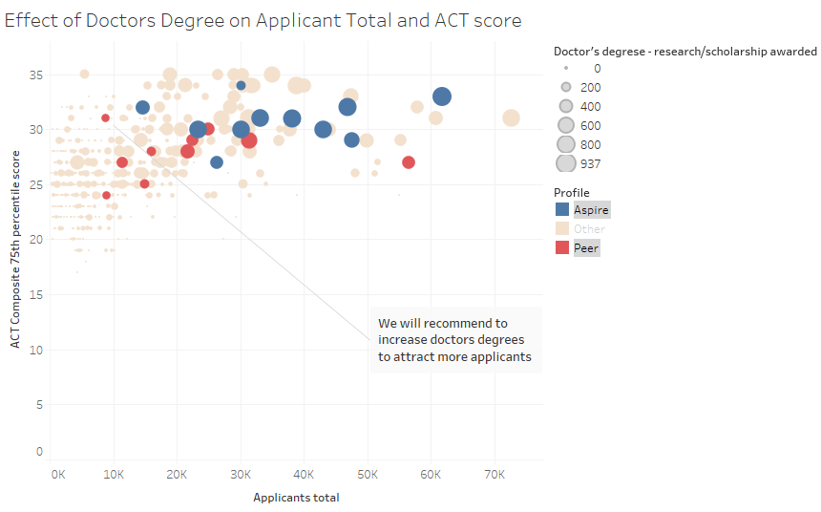
Effect of Doctor’s Degree on Applicant Total and ACT score
Tableau
We observe from plot that ACT Composite 75th percentile score for UTD is in the range of Aspire universities, but UTD is lacking in total applicants. UTD can increase applicants total by increase in doctor’s degree - research/ scholarship.

Slide 3
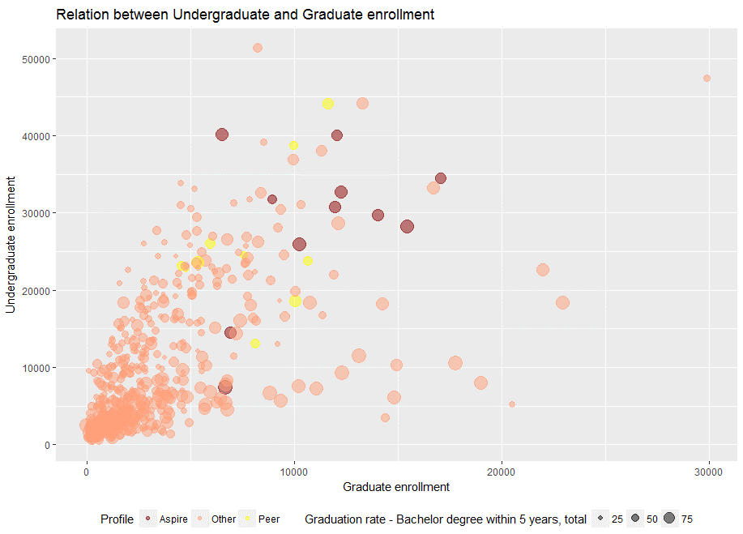
Relation between Undergraduate and Graduate Enrollment
ggplot2
We infer from the bubble plot that undergraduate enrollment in UTD is very less compared to aspire universities. Although UTD is providing graduate enrollment almost in the same range of aspire universities. UTD can increase graduation rate by increasing undergraduate enrollment.

Slide 4
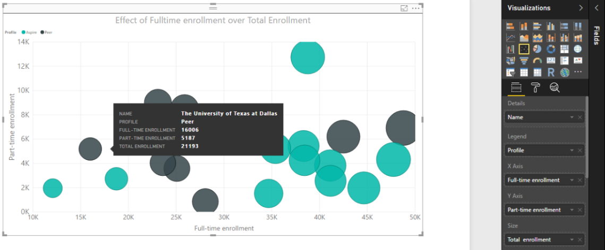
Effect of Full time enrollment over Admission Total
Power BI
We observe from plot that Full time enrollment is more compared to part time enrollment for aspire universities.
Aspire universities have larger enrollment total size.
Hence UTD can focus on increasing full time enrollment keeping the part time enrollment in proportion like aspire universities.

Slide 5
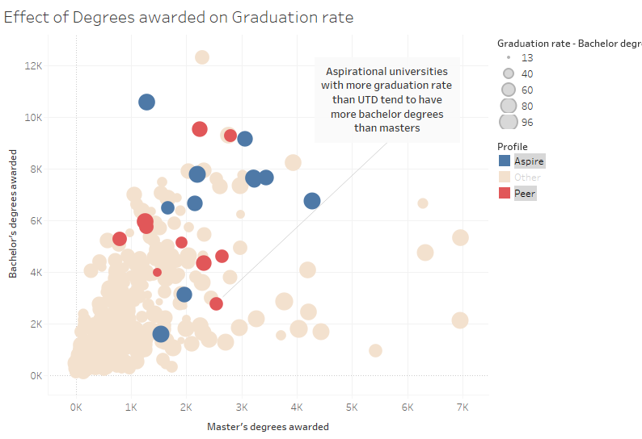
Effect of Degrees awarded on Graduation Rate
Tableau
We infer from the plot that number of bachelor’s degree awarded is higher for aspire universities.
P.S.-Size represents Graduation rate-Bachelor degree within 5 years, total

Slide 6
Recommendations
UTD can try to increase tuition fees to increase endowment. Increase in endowment will help to increase research activities.
UTD can increase total number of applicants by increasing doctor’s degree-research/scholarship, as this will imply that UTD focuses more on research.
(Refer Appendix for further information explored)
UTD can increase graduation rate by increasing undergraduate enrollment.
UTD should try to improve the ratio of Bachelor’s degree awarded to Master’s degree awarded and increase the graduation rate like aspire universities.
UTD should prefer full time enrollment over part time enrollment.

Slide 7
Appendix
https://www.reputationmanagement.com/blog/academic-reputation-important-factor-college-choice/
https://www.timeshighereducation.com/world-reputation-rankings-2014-methodology

